Slide 1
Hackathon’25 : Solve Rubik’s Cube

Slide 2
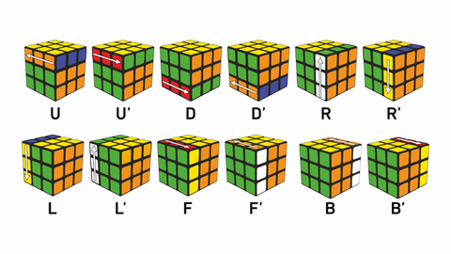
Solve Rubik’s Cube
Overview
Participants are challenged to design and implement an algorithm that can solve a standard 3x3 Rubik’s Cube from any scrambled state. The solution must mimic the real-world logic of solving a cube through a sequence of valid moves.
What We’re Looking For : 🔍
Problem-Solving Approach
How do you break down the problem?
How do you model the cube’s state and transitions?
Use of Data Structures
How do you represent the cube internally (e.g., arrays, trees, graphs)?
Use of efficient structures to track states and operations.
State Prediction Logic
Ability to track and predict cube state after each move.
Design of a move engine to simulate rotations and track permutations.
Algorithm Efficiency
How fast can your solution reach the solved state?
Complexity (time and space) of your algorithm.
Bonus Evaluation Areas
Creativity in solution design.
Visual simulation or cube UI (optional but Wow factor).
Scalability for different cube sizes (2x2, 4x4, etc.) : Optional
Deliverables:
Working algorithm (code)
Brief walkthrough/presentation of your approach
Output example(s) from your solver
It’s Not Just a Puzzle - It’s a Test of Mind, Math, and Moves!

Slide 3
Problem understanding
Solving a scrambled 3x3 Rubik’s Cube using valid face rotations only.
The cube has over 43 quintillion possible combinations.
The algorithm must provide a real-world cube-solving logic that is fast.
Focus on efficient state tracking and valid move simulation.
Final goal is to return the cube to its solved state with minimal moves.

Slide 4
The approach
Representing the cube using 6 faces- Up (U), Down (D), Left (L), Right (R), Front (F) and Back (B).
Each face is a 3×3 grid stored as a list.
Defining the functions to simulate all valid face rotations.
Used a solving algorithm to figure out the right sequence of moves.
The output includes a step-by-step solution that can solve any scrambled cube.

Slide 5
How I represented the cube

